Slide 1

Progress Presentation
18-12-2024
Prepared by: Marie Joe Sawma To: Dr. Reed Maxwell

Slide 2
Objective
Running the Simulation Based inference to get the Posterior distribution

Slide 3
Single Column : USNe -2
To be able to capture the range of Hydraulic conductivity effectively, we conducted five simulations in total. This approach was chosen to ensure the identification of pattern for the data.

Slide 4
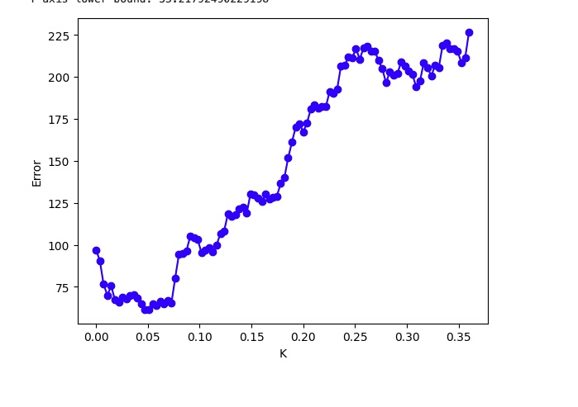
Prior Distribution

Slide 5
Posterior Distribution

Slide 6
Hydrological Model Example
Trying to run the example provided by Dr. Peter Melchior to become familiar with creating virtual environment for SBI .

Slide 7
Virtual Environment for SBI
Install Anaconda
Work on my own terminal to create a virtual environment to run the example
Run the code on visual studio

Slide 8
Steps to create virtual environment
Install Anaconda
Work on my own terminal to create a virtual environment to run the example
Run the code on visual studio

Slide 9
Steps to create virtual environment
conda create –name sbi python 3.9
conda activate sbi
conda install numpy = 1.24.3
pip install superflexpy
pip install sbi
pip install corner
pip list
open visual studio
run the code

Slide 10
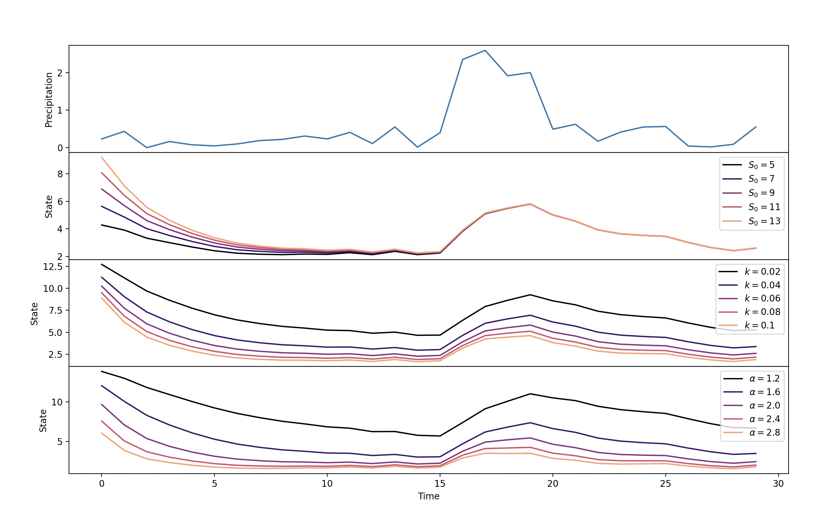
Outputs

Slide 11
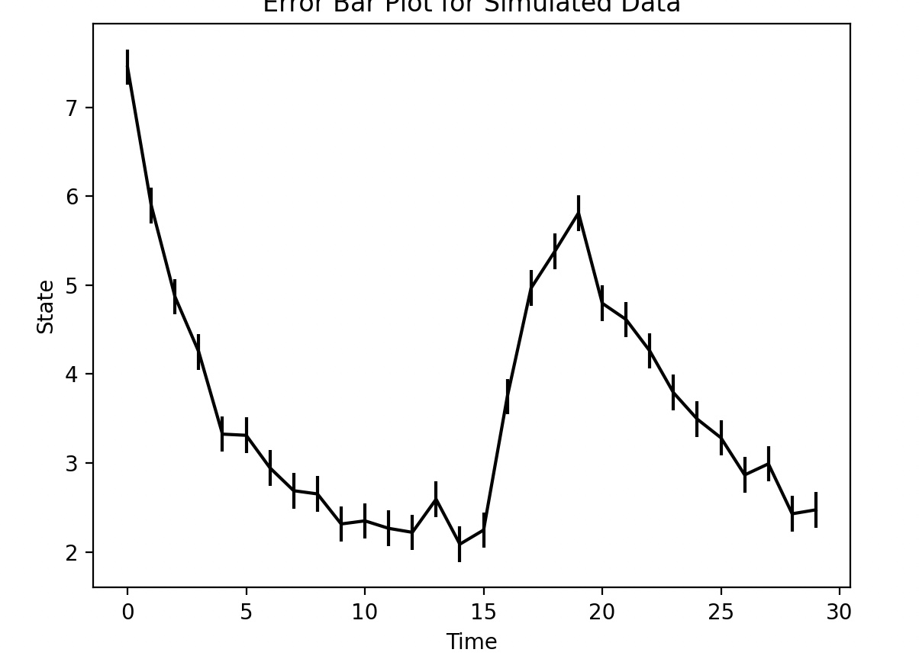
Outputs

Slide 12
Error
Regarding the creation of the environment to run the example, I faced the following problem:
I had a conflict with numpy packages where:
numba 0.57.1 requires numpy version between 1.21 and 1.25
Superflexpy requires numpy of 1.24.3
Python version (3.9)

Slide 13
Error
Error in the last two cells

Slide 14
Plan of this week
Running Amanda’s script
Start by figuring out a method to com up with the posterior distribution of the hydraulic conductivity

